Slide 1


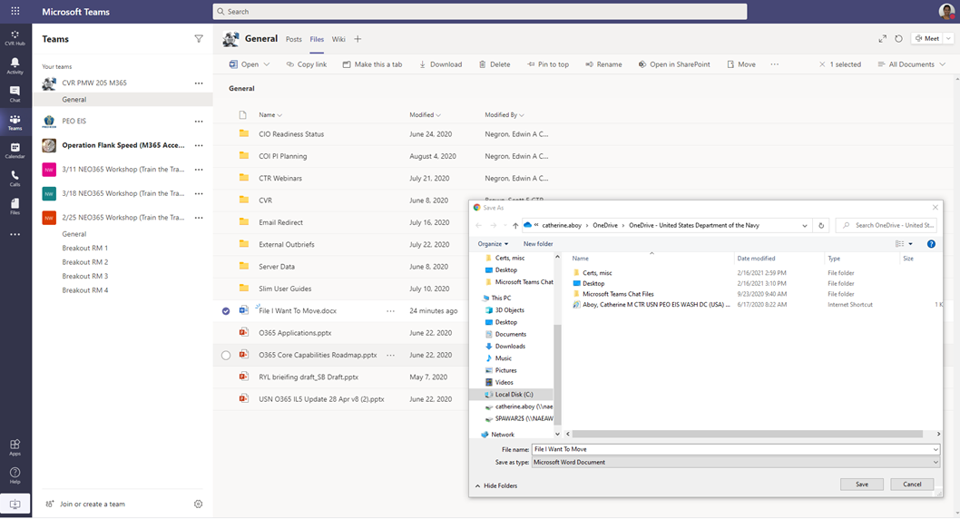
How-To:
Migrate Your Data from CVR (IL2) to Navy M365 (IL5)
Step 1: Move Your Files from CVR to NEO365 OneDrive or Locally
Select the files you want to move, then click Download
From the Download window, select OneDrive – United States Department of the Navy (or a local folder) → select the folder you wish to put them in → click Save

Slide 2
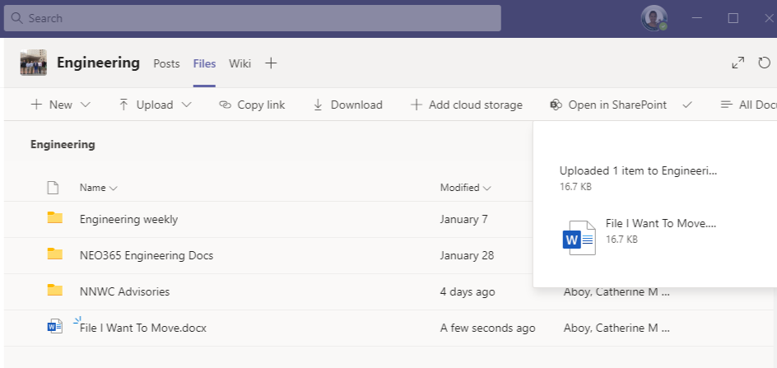
How-To:
Migrate Your Data from CVR (IL2) to Navy M365 (IL5)
Step 2: Move Your Files from OneDrive to NEO365/Flank Speed
NEO365/Flank Speed Users: The files you selected to download will sync to your OneDrive. You will see a green checkmark in a circle next to the file(s) name indicating a successful download and sync to your local OneDrive. Then you can drag or upload those files into your chosen location within NEO365 or Flank Speed Teams.
*Non-NEO365 users: Users who saved to their local folders can move their files to NEO365/Flank Speed once their IL5 cloud access is available.
File Successfully Uploaded to IL5 Teams

